Slide 1
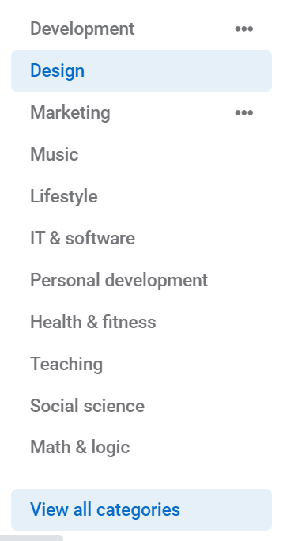


Learning Resource Plaza
Central Library

Slide 2

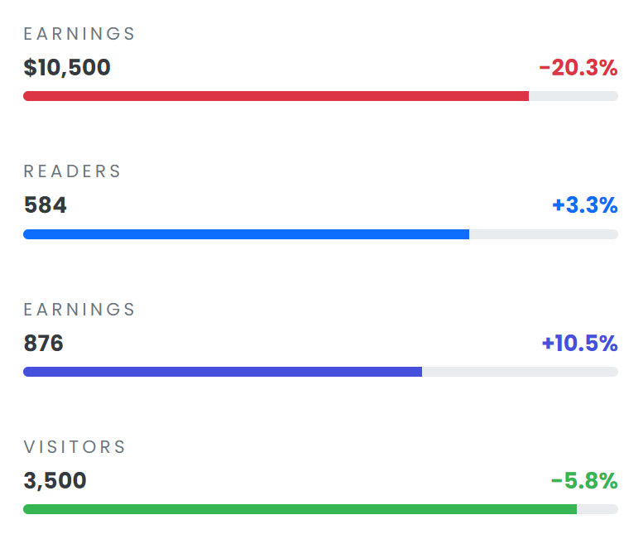

Slide 3
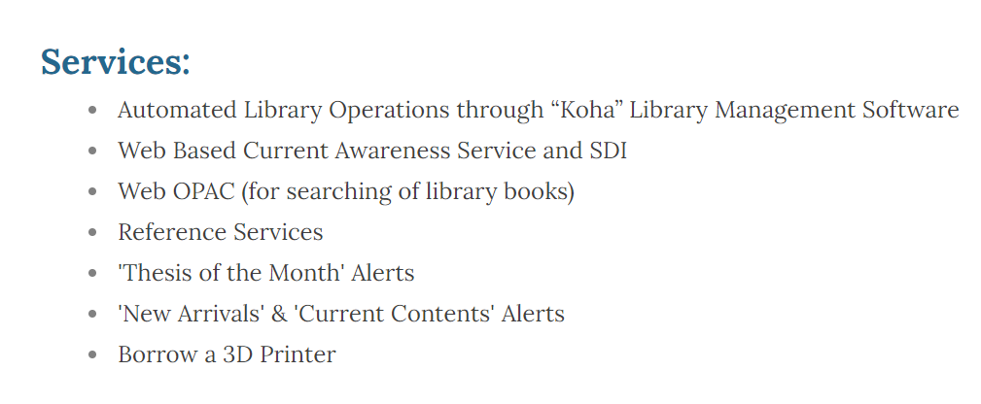
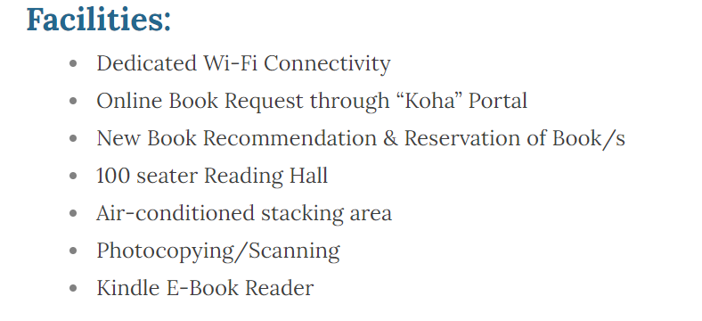

Slide 4

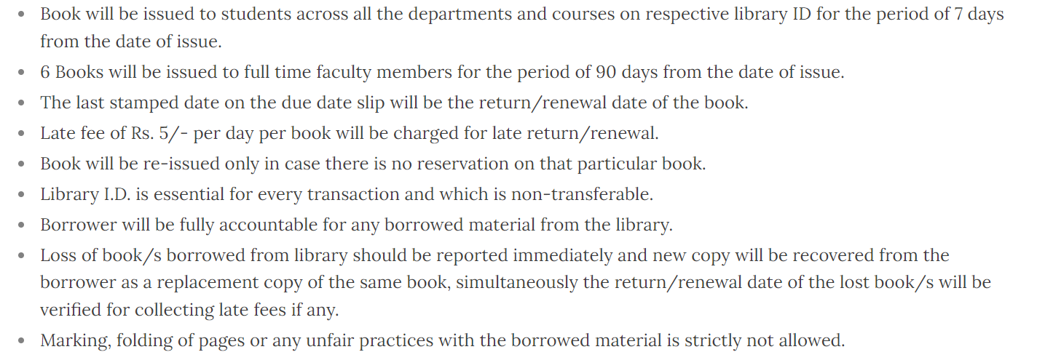
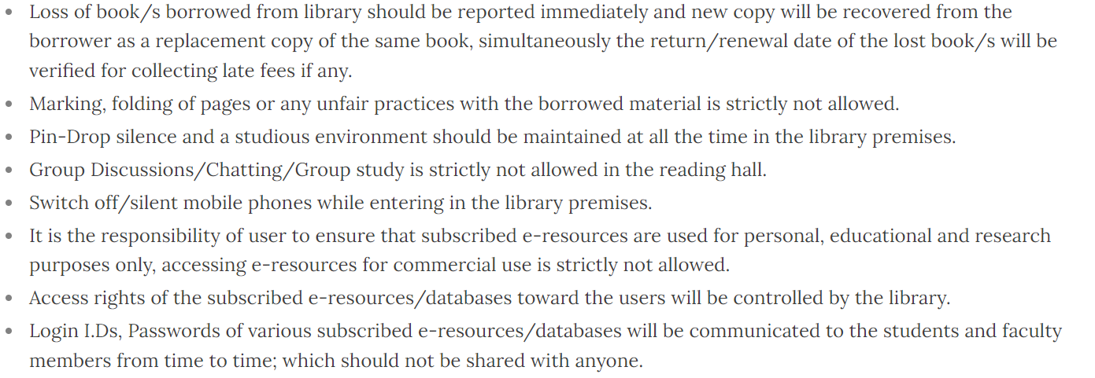
Rules

Slide 5

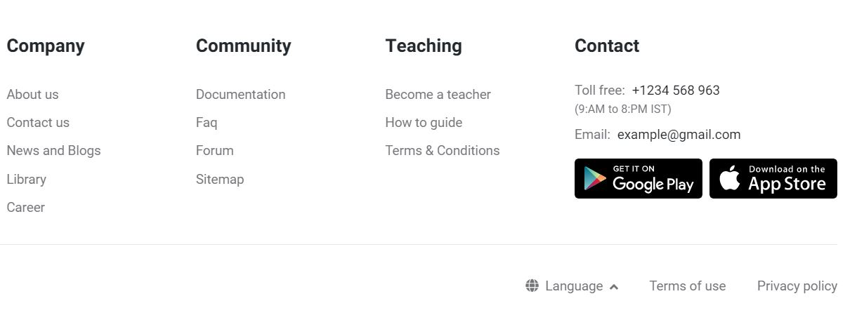
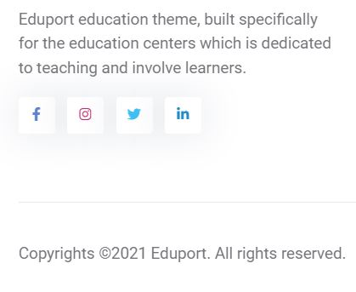
Team

Slide 6
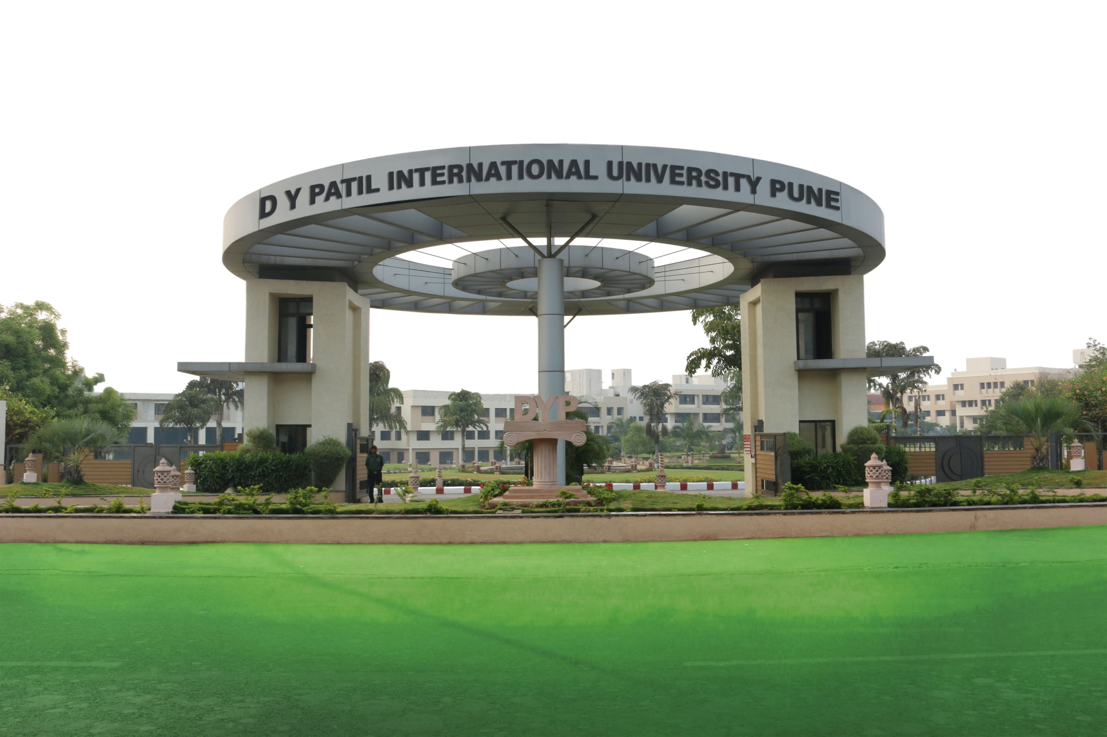
About US
The core objective of an academic library is to fulfil the information needs of its stakeholders by making available predominant sources of information and provision of information services. As it has been presumed as the heart of every institution, the overall health of the parent institution depends on it. DYPIU’s “Learning Resource Plaza” (Central Library) holds the rich collection of text as well as reference books in the domain of Computer Science, Biotechnology, Biomedical. ​

Slide 7

Engineering, Design, Management, Pharmacy, Engineering and Technology and allied domains of knowledge. It’s collection comprise of printed documents such as Books, Research Journals, Technical Magazines, Project Reports etc. ; whereas E- Books, E-Journals, E-Thesis, E-proceedings and other E-Databases, CDs/DVDs etc. are hosting the e-resources collection counterpart

Slide 8

Vision and Mission
Vision: To Become a Premier Learning Resource Partner by Hosting the Hybrid Information Resources, Ultra-Modern Library Facilities and User Centric Information Services to Contribute towards the “Knowledge Society”.
Mission:
​To Provide Seamless Access to Comprehensive Range of Information Resources to its Stakeholders.
To Adopt Best Practices and Serve with Excellence to Support the Institute’s Academics and Research Intellect.
To Ensure Effective Utilization of Information Resources, Services for the satisfaction of its Stakeholders.

Slide 9
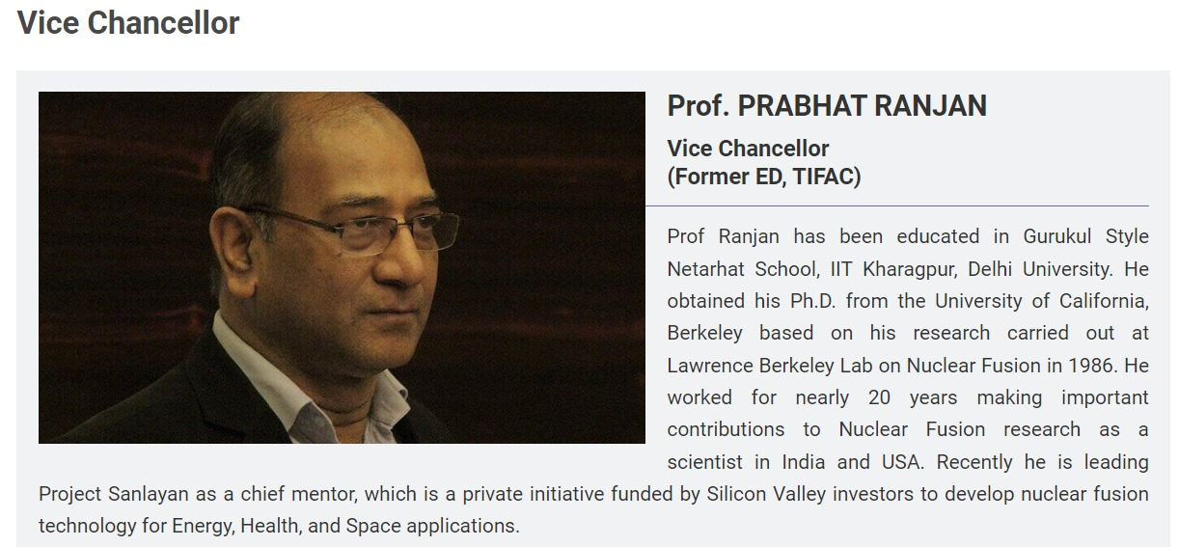
Committee Members

Slide 10
Team Members

Slide 11



